Slide 1
IMF (East AFRITAC)
Regional Public Financial Management (PFM) Workshop
Strengthening Budget Documentation
Session 1.1-Developing and communicating the Strategic plan
Kubai Khasiani
Entebbe, Uganda
Nov. 27

Slide 2
Outline
Overview of Strategic Planning
Development Planning in Africa
Case study: The Mid Term Review of the Uganda National Development Plan (NDPI)

Slide 3
Purpose and motivation for Strategic Planning
Strategos literally means general of the army. Strategoi in ancient Greece, advised the ruler about managing battles to win wars as opposed to managing troops to win battles. Strategic planning is about the big picture. It is more about defining outcomes than how to achieve the outcomes.
  It provides a solid foundation for aligning resources in a systematic way as opposed to being simply in a “reactive mode.”
  Is aimed at being more focused on critical issues
  Attempts more adequately to link strategic planning with budgeting
  Strives to better coordinate policy concerns, and to increase communication at all levels
Basically, a strategic plan would indicate …overall mission, goals and objectives, strategic or programmatic activities, and resources (people, monies, technologies, facilities, etc.) performance and what results are actually being achieved . Wikipedia
comprehensive planning-a continuous process of rational, deliberate, consistent and coordinated economic policy making

Slide 4
Strategic Planning is getting the best fit!
The Best Fit
Mission
What you want to accomplish
Opportunities and Threats
Needs of customers and other stakeholders
Competitors and allies
Social , economic, political and technological forces
Strengths and weaknesses
Capabilities
Resources

Slide 5
Generic features of strategic planning
A situational analysis of the strengths and weaknesses- SWOT.
A vision and mission statement
General goals, specific targets or objectives, and performance measurements to progress;
A set of “action” strategies to accomplish goals and objectives;
Implementation of detailed operational or tactical plans
M&E.

Slide 6
Benefits
Provides a long-range, unified and broad direction (a “plan”)
Facilitates more responsive, and accountable leadership to the current and emerging needs of the state
Structures the allocation of limited resources in a more rational, and “results-producing” way
Enhances communication and better coordination of the policy/fiscal decision-making process.
Provides the basis for measurement of the progress of strategic efforts and the updating or revision of these efforts as warranted

Slide 7
Translating a dream into reality
Long Term Development Plan-Vision
Medium Term Plans (5 year)
Sector Plans
MTEFs
Sector Plans
Sector Plans
MTEFs
MTEFs
MTEFs

Slide 8
Development Planning in Africa
Killick, 1983:57 concluded that “the available evidence on plan execution
in Africa has been negative. The negative performance recorded included:
  over-ambitious formulation of targets;
  limited success in meeting planned targets;
  wide dispersions about target levels;
  failure to modify the impact of market forces; and,
  failure to put development plans into effect.
Killick, 1983:58) also found that the deficiencies in plan implementation were in:
  plan documents;
  institutional and
  bureaucratic weaknesses (including inadequate planning resources);
  exogenous shocks; and
  political factors
Examples of deficient plan documents included:
  Chad (absence of financial programming),
  Ghana (serious technical flaws in the seven-year plan),
  Kenya (internal inconsistencies in the third and fourth plans), and
  Tanzania (insufficient provision for an implementation machinery for all plans).
Notes:
Accelerated Development in Sub-Saharan Africa: An Agenda for Action” (Killick, 1983: 74).“ was an evaluation report on Development planning in Africa originally prepared for the World Bank’s African Strategy Review, to inform the Berg report of Structural Adjustment Programs. The objective of the evaluation exercise was “to review the literature on plan implementation in Africa, with implementation defined as the ability to achieve specified ends by chosen means. Though highly balanced the eventual evaluation report was constrained the availability of the relevant literature.

Slide 9
Strategic Plans in the Region
Country | Long Term Plan | Medium Term Plan and related documents
Eritrea | Sector Development Plans | National Development Plan
Ethiopia | Poverty Reduction Paper (PRSP) | Growth and Transformation Plan II
Kenya | Vision 2030 | Medium Term Plan II
Malawi | Vision 2020 | Malawi Growth and Development Strategy(MGDS)
Tanzania | Vision 2025 | MKUKUTA- National Strategy for Growth and Reduction of Poverty Five Year Development Plan
Rwanda | Vision 2020 | EDPRSII- Economic Development and Poverty Reduction Strategy II
Uganda | Vision 2040 | National Development Plan Public Investment Plan Sector Investment plans District Development Plans Local Government Development Plans
Zanzibar | Vision 2015 | MKUZA- Zanzibar Strategy for Growth and Reduction of Poverty
Notes:
National development plans are underpinned by sector plans and strategies
Different policy objectives across countries but high level of commonality
Most guided by a Vision ranging from 2020 to 2040

Slide 10
A review of Strategic Planning in Uganda
A number of economic policies and programs have been successfully implemented
  Structural Adjustment Programs (SAPs),
  Economic Recovery Program (ERP),
  Poverty Eradication Action Plan (PEAP)
In 1999 and 2007, Uganda developed Vision 2025 and draft Vision 2035, respectively.
However, these were not operationalized mainly due to absence of appropriate policy, legal and institutional framework, and lack of ownership at different levels of leadership
Notes:
Mid-Term Review of the Uganda National Development Plan
Prepared by Delta Partnership and REEV Consult for the National Planning Authority

Slide 11
Uganda Vision 2040
In 2007, the Government approved the Comprehensive National Development Planning Framework policy (CNDPF) which provides for the development of a 30 year Vision to be implemented through: three 10-year plans; six 5-year National Development Plans (NDPs); Sector Investment Plans (SIPs); Local Government Development Plans (LGDPs), Annual work plans and Budgets.
Cabinet approved the National Vision Statement, “A Transformed Ugandan Society from a Peasant to a Modern and Prosperous Country within 30 years”. The National Planning Authority in consultation with other government institutions and other stakeholders developed the Uganda Vision 2040 to operationalize this Vision statement.

Slide 12
National Development Plan (NDP I)
2010/11 – 2014/2015
Was the first of a series of 6 NDPs which collectively are expected to pave the way for the attainment of objective and targets set out in the Vision 2040
A mid Term review carried between March and September 2013 assessed achievements, barriers to greater success and what can be done going forward for improvements

Slide 13
Mid Term Review(MTR) of the NDP I
Overall assessment identified need for:
  greater focus and priority setting
  full alignment of other plans and mechanisms with the NDP
  streamlining institutional roles and responsibilities
  increased efficiency and effectiveness in the use of funds
  greater common national ownership of the NDP

Slide 14
Legal and Institutional mandates
This is about effectiveness of planning institutions
Findings
Legal and regulatory frameworks not supportive of national development
The NDP alone is inadequate to provide the development policy and strategic direction to the ministries and sectors.
For example ,parallel planning programs continued to be undertaken by MoFPED, often without involvement of the NPA
And, OPM continued to coordinate implementation of the public sector programs and policies without major review of its institutional structures to focus on the NDP

Slide 15
Legal and Institutional mandates
Recommendations.
Integrate and institutionalize the role of setting the development policy agenda in NPA Act, 2002
Establish a platform to produce a national oversight report constituting key oversight players including NPA, Parliament and NGO Forum.
The report should be presented annually to the Plenary of Parliament to facilitate follow-up of key recommendations and findings on national development issues.
How is done elsewhere?
Value added?
Notes:
Rwanda has an adequate institutional and legal framework for plan implementation, but with flexibility to change or adapt which has proven effective (e.g. RDB,).
Merging institutions with closely complementary mandates has reduced duplication of efforts and improved coordination

Slide 16
Financing the plan
This is about funding resource requirements and strategies
Findings:
Financing strategies including sources of finance not precisely specified in the NDP
The levels of funding for national development were not enough to achieve many of the NDP targets
For example the on-budget NDP cost envelope over the 5 years was estimated at UGX 51,000b and the on-budget MTEF managed by MoFPED expected to reach around UGX 47,000b.
The full picture of required funding included UGX 20,000b of off-budget finance and UGX 17,000b of funding to be generated elsewhere, primarily from the private sector
The MTR noted there was lower than expected economic growth and tax take in the first half of the NDP period, implying insufficient funding NDP implementation.

Slide 17
Financing the plan
Recommendation
Though the NDP was very comprehensive it needed a sense of priority e.g better defined sequencing plan with clear milestones for each year, linked particularly to the implementation of core projects
What is your experience?
Notes:
Discussion around financing the Plans across the region?????

Slide 18
Effective Strategic Focus
This is about the getting the best fit. What the country can do best.
Findings
Lack of a rigorous framework for setting out priorities for national development
Lack of a framework for coordination in setting up national cross cutting policies and strategies.

Slide 19
Effective Strategic Focus(3)
Recommendations
Have a more focused theme for the NDP, with sequencing of implementation to overall national development.
Have a smaller set of no more than 6 strategic development objectives and no more than 3 ‘gold medal’ indicators for each one with ‘Top 10’ indicators to focus minds and public attention;
Focus on an understanding and communication of national development as measured against the ‘gold medal’ indicators, ensuring that data is available and analyzed by District, region, gender, income group etc. for each one where applicable;
Establish a body with a mandate to provide a central locus for national guidance on policy and strategic direction to vet all national policy reforms and choices at the highest level in national interest without political interference

Slide 20
Effective Strategic Focus(4)
Make the 5 year NDP fully synchronized with other major planning and financing mechanisms so that it matches with a 5 year MTEF, a 5 year PIP and 5 year sector Investment Plans) (SIPs) which all start and end at the same time as the NDP
Introduce an annual NDP stock-take process with some limited scope for modifying the plan during the course of its implementation, whilst it keeps major national development priorities constant
Use the NDP as the ‘centre piece’ for all major national level performance monitoring, evaluation and reporting
Reform the Government Annual Performance Report (GAPR) by changing the format for sector performance reports and refinement of JAF reporting, linked to the other recommendations set out above
Use the same modelling framework by the NPA and MoFPED and Bank of Uganda) (BOU) to enhance ownership of the macroeconomic framework across the three institutions
What is the experience from other countries?
Notes:
Rwanda EDPRS 2 purposefully places an equal focus on Sector Strategic Plans and District Development Plans, and on the interface between them, in order to move to a development model that is tailored to the differential needs of different parts of the country.
Foundational issues in the EDPRS2 are as strategic areas that constitute the bedrock of Rwanda’s sustainable development over the long term.

Slide 21
Basis for efficient resource allocation
The Plan should provide the framework for efficient equitable and effective resource allocation
Findings
Platforms for reconciling competing expenditure needs are neither efficient nor effective
Selection of priority funding not based on objective criteria. In some cases, simply geared to securing higher levels of funding
Lack of consistent expenditure policy over the medium term e.g. across the board budget cuts introduced midway affects planned implementation
Large amounts of money dedicated to the national level projects which, together with increases in the number of district level administrations in Uganda, has reduced the proportion of resources available for service delivery at the local level

Slide 22
Basis for efficient resource allocation(2)
Recommendations
Conduct a review of Sector Wide Approach / Sector Working Groups and the way they enhance inter-sectoral efficiency and links for NDP implementation and assess the scope for cross-sector funding mechanisms
Put in place a mechanism for fair estimates of the interventions to facilitate derivation of the Government MTEF with its key components-(costing framework).
The proposed MTEF and annual budgets should reflect objectives set out in the NDP

Slide 23
Basis for efficient resource allocation(3)
Recommendations
The assessment in the different annual performance reports including Ministerial Policy Statements, the annual sector review reports and the annual budget performance reports should also reflect the NDP objectives.
Align the Budget Framework Papers, Ministerial Policy Statements, the PIP, SIP, to the NDP priorities;
Develop a long term investment planning framework that will help target high priority projects to be included in the NDP
What is the experience from other countries?
Notes:
All MDAs now expected to attach a Certificate of compliance to their submission of the annual budget(PFM Act 2015).
MoFPED through the PAP department is implementing an investment planning framework

Slide 24
Analytic Basis
The Plan should be aligned to a system that enables analysis and measurement
Findings
Lack of a framework therefore -limited performance reporting and difficulties in attributing outcomes to outputs; and outputs to inputs.
Country specific economic sectors only partially aligned to International Standards (COFOG) making it difficult to compare different functional-across sectors countries
Defined percentages of budget allocated to various sectors
While there may be some level of analysis for formulating the budget and allocating funds….this is not utilized for reporting purposes, e.g. in IFMIS

Slide 25
Analytic Basis(2)
Recommendations
Purpose of spending should be defined in the Program/Sub-Program/ segment of the Chart of Accounts (CoA) and related classifications mapped to this segment
Ensure that all expenditure management systems are well aligned to the new NDP.
Increase use of COFOG classification, via mapping to the program segment (e.g. at sub-program level)
Designing the programs around policy objectives and priorities from the outset rather than designing the program and then assigning it to a priority
Greater focus on performance and outcomes: outputs over inputs
What is the experience from elsewhere?

Slide 26
Timing, Decision points and Coordination
This is about the process, precise “action plans or steps” and accompanying sufficient details regarding these steps
Findings
Inadequate established lines of reporting and communication, who is responsible for what ?
Unclear and multiple decision points?
Capacity challenges?
Planning and coordination not comprehensive

Slide 27
Timing, Decision points and Coordination
Recommendations
Clear coordination mechanisms be instituted to synchronize planning, implementation, monitoring and evaluation
Establish optimal levels of structures and staffing levels, and motivation for effective delivery of the NDP.
Need to strengthen capacity at the districts to undertake effective analysis and harmonization of ordinances and bye-laws for their faster implementation
Need for a mechanism within CSOs to report on their performance and contribution the NDP as well as further alignment of their activities to the NDP
How do the others deal with the challenges?

Slide 28
Monitoring Framework
This is about assessment and procedures for corrective action.
Findings:
lack of an NDP–specific monitoring and evaluation system
Lack of clarity in leadership on all M&E (for public and non-state actors)
For example, MoFPED continued to undertake the role of budget monitoring, without harmonizing with that of budget performance monitoring which was envisaged to be undertaken by OPM in line with the NDP
Lack of a National Standard Indicator framework based on the overall goal and objectives of NDP II and the key regional and international development frameworks that Uganda is party to.
Many NDP results indicators were either proxy or indirect in nature and were not completely valid in determining actual progress on the desired NDP results.
Un-matched timing in the release of the data(mostly from UBOS) required to monitor NDP progress
The basis for setting the respective target values was more mathematical than objective eg income per capita growth numbers were set without a technical basis rising from USD 670 to USD 9700 over 30 years
Notes:
Progress-4 levels of standard indicators developed
National Priority indicators: The NSI Level 1 presents key indicators that will be tracked at national level to monitor the country's graduation from LDC to Medium-Income status
Program outcomes and indicators: The results from implementing NDP II sector objectives and the respective sector interventions will be monitored at NSI level2
Service delivery outcomes and indicators: Level 3 of the NSI framework contains MDA Service Outcome and indicators for the annual assessment of MDA performance against the MTEF allocations
Routine outcomes and indicators: MDAs and Local Governments undertake routine activities in the delivery of the public services which influence service delivery outcomes.

Slide 29
Monitoring Framework
Recommendations
timing of the vital social economic surveys should be adequately collaborated with the NDP reporting framework
Notes:
Lessons from Kenya and Ethiopia
In Ethiopia the BSC and the PBB have competing roles
In Kenya ?

Slide 30
Accountability /Results Framework
This is about a specific method or procedure to achieve or ensure overall accountability for the implementation process; about detailed, measurable objectives or projected results along with timelines- when it is to be completed
Findings
Performance generally mixed and largely below expectation
A few targets less ambitious than current levels.
Some targets, for example the 100 per cent access to safe water in urban areas clearly unachievable without financing in access of the levels in the NDP.

Slide 31
Accountability/Results Framework(2)
Findings
Around half the baselines and many annual targets missing for the NDP performance indicators, making it difficult to assess progress in many important areas
Most of the indicators without sound baseline data that can be used as a basis of judgement.
Most indicators lack measurable annualized targets making it difficult to assess progress
Implementation of core projects and other development investments seriously constrained by limited access to finance and land disputes.
Development planning considered in piece-meal way and many potential synergies and intra-sector efficiency gains not untapped

Slide 32
Accountability/Results Framework(3)
Recommendations
Need for consensus building on the top down and bottom up planning paradigm to develop ownership and inclusiveness- But How?
Identify and select a small number of strategic objectives and key performance indicators (KPIs) for monitoring?
Develop appropriate baseline figures for all KPIs ?
Need for a set of overarching drivers of prioritization and resource allocation that cut across sectors, for example the transformation of agriculture, skills development and urbanization.
Build awareness and capacity of parliamentarians to enhance appreciation of their oversight roles to ensure alignment of government business with the NDP
What is the experience from the region?

Slide 33
The Case of Social Accountability in Rwanda
This is about Users and ownership of the plan who should identified in the Development planning guidelines
Findings from EDPRS
Ownership of the EDPRS by a wide range of stakeholders at national level has been a key factor of success. The EDPRS 2 has integrated inclusiveness and sustainability as driving factors in elaborating the strategy.
Home-grown initiatives turned into success stories in strengthening delivery of EDPRS
These include: Umuganda (community work), Gacaca (truth and reconciliation traditional courts), Abunzi (mediators), Imihigo (performance contracts), etc.
Scale up of home grown solutions forms an integral part of the EDPRS 2 with particular focus on identifying innovations.
Is this unique to Rwanda?

Slide 34
How do these plans link to the budget?
Findings
Some misalignment between sector financial allocations within the NDP and allocations within the MTEF
Indicative analysis suggests that only a relatively small proportion of NDP priority sector projects funded through the Public Investment Plan.
Funding of NDP projects not based on any firm prioritization process.
The NDP does not focus on results outside MDAs and local governments.

Slide 35
How do these plans link to the budget
Recommendations
Policies and strategies should be aligned
Need for multi-sectoral approach in the formulation of budgets linked to interventions to achieve the specific objectives.
Consultations and consensus in the budget process needs to go beyond the Sector Working Groups to the higher level coordinating organ that will ensure that this multi-sectoral approach has been catered for by the respective sector budgets.
Align financial resources behind priorities, and ensure that the NDP both informs and is informed by political priorities for the development of Uganda.
NDP scope should be expanded to cover private sector.
Notes:
Uganda has got very elaborate and comprehensive budget documentation, why does it have challenges?

Slide 36
Collaboration with Development Partners
Recommendations
Government should emphasize on linkage of all ODA to the NDP priorities. All the donor funded programs must be linked to the NDP and no resources should be allowed in the country unless they are linked to the implementation of the NDP priorities.
Government should improve on project appraisal, selection and design and avoid supply driven interventions
Closer consultation with donors will provide a basis for detailed discussions over government expectations about the way in which aid should be aligned behind NDP objectives including both the modalities for delivering aid and its sector focus
Sounds familiar?

Slide 37
Regional and international collaboration
Findings
A number of international commitments appear not to be consistent with the domestic legal and regulatory frameworks and the overall policy and strategic direction.
  Abuja Declaration- health
  Maputo Declaration- agriculture
Uganda has already committed itself to international dispensations that are not in tandem with national fiscal policy and strategic direction
Notes:
What are your thoughts?

Slide 38
Some Questions about the National
Plan
Is the National Development Plan:
A comprehensive national plan which informs all sectors and all local governments on what they need to do over the medium term with minimum scope for deviation?
OR
Does it just provide a strong strategic steer to sectors which guides them in what they do, but does not dictate to them?
OR
Is it just primarily a Government development document or a broader country development document which does not cover the private sector?

Slide 39
Thank You

Slide 40
Developing and communicating the fiscal strategy
Bryn Battersby
Uganda
November 2017

Slide 41
Outline
The Medium Term Fiscal Framework
  What is it, and how does it fit with the Budget?
  Fiscal policy, and why it’s important
  The role of macro-fiscal units
Documenting the framework
  Fiscal transparency
  The fiscal framework in the Budget

Slide 42
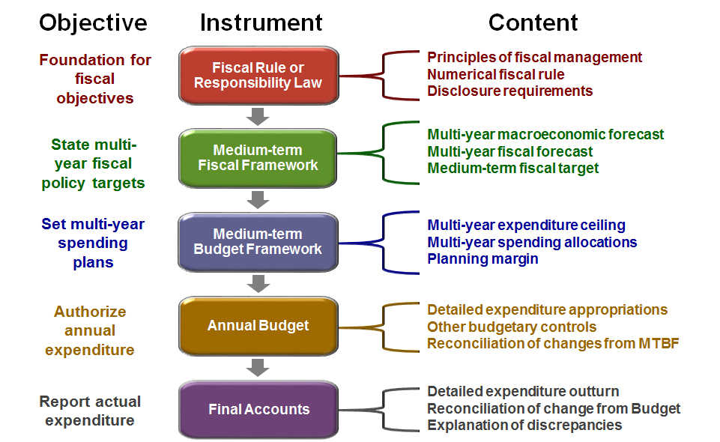
Medium term fiscal framework

Slide 43
Medium term fiscal framework
  What is it?
A set of medium-term macro-fiscal forecasts: aggregate level of revenue, expenditure and financing
A comprehensive statement of fiscal policy objectives and targets consistent with macroeconomic stability and fiscal sustainability
      Embedded within realistic and internally consistent medium term macroeconomic projections.
      Best practice supplements this with transparent assessment of fiscal risks
Fiscal objectives can be expressed in many different ways, but should be transparent; stable; comprehensive; and realistic

Slide 44
What is fiscal policy?
  The term fiscal policy refers to the use of public finance instruments to influence the working of the economic system to maximize economic welfare.
  The economic effects of fiscal policy reflect not only the impact of the fiscal balance, but also various elements of taxation, spending, and financing …
  … by all levels of the government

Slide 45
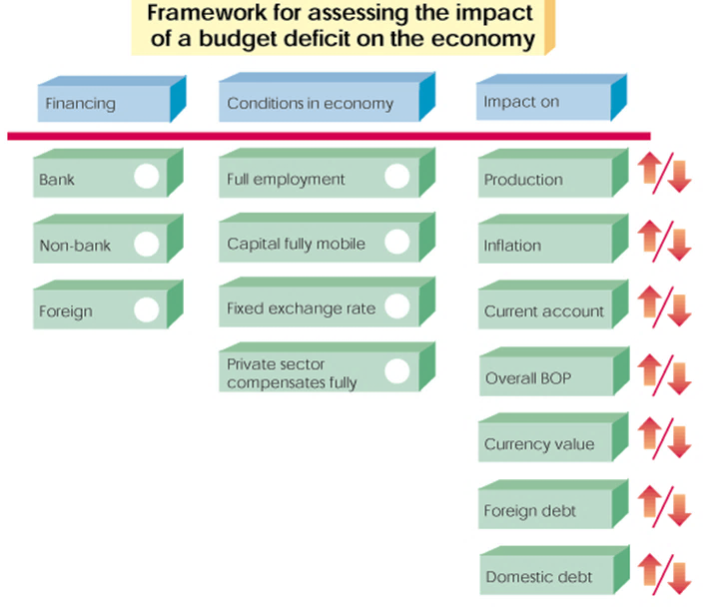
Assessing the Impact of Fiscal Policy

Slide 46
Fiscal Policy and GDP
GDP = C + I + G + NX
C = Consumption
I = Investment
G = Government
NX = Net exports
Fiscal policy affects GDP:
Directly through G
Indirectly through C (taxes, expectations), I (interest rates, confidence), NX (demand for imported goods, supply of exports, the effect of fiscal policy on the exchange rate)

Slide 47
Optimal Fiscal Policy (theory)
  Countercyclical fiscal policy can be an effective tool for stabilizing the economy:
    In an expansion, the government should avoid overheating the economy by reducing spending and/or increasing taxes
    In a recession, the government should stimulate the economy by increasing spending and/or lowering taxes
y^{p}
y
Cyclical Fluctuations
t
    Automatic stabilizers and discretionary measures (fiscal stimulus) can help implement counter-cyclical fiscal policies

Slide 48
Fiscal Policy (reality)
In reality, fiscal policy in many countries is often pro-cyclical.
    Often, this is because of supply of credit and political distortions:
      In booms:
        Governments can borrow more easily
        Higher revenues allow higher spending
        Leaders find it harder to resist demands when times are good
      In busts:
        Governments cannot borrow (or can do so only at very high interest rates)
        Lower revenues force lower spending when fiscal rules apply (cannot run deficits beyond certain level)

Slide 49
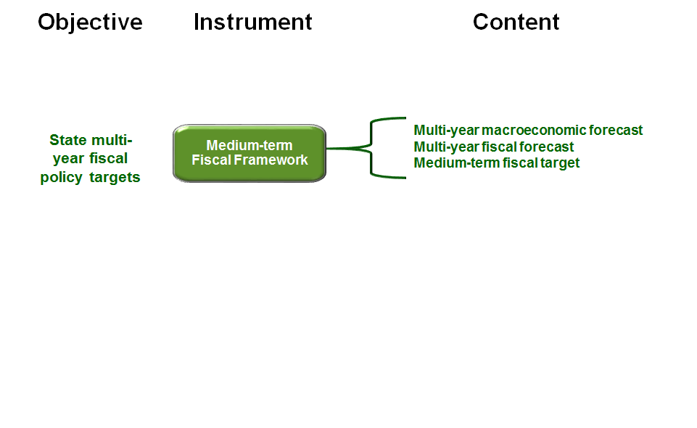
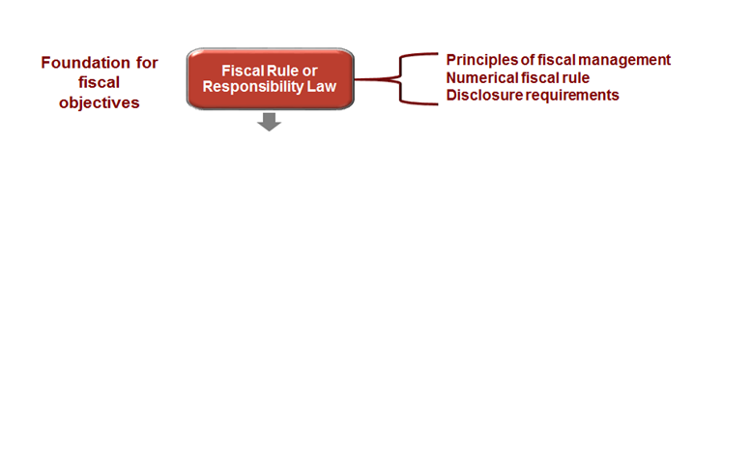
Fiscal rules or responsibility laws help to define the scope of the MTFF
A fiscal policy rule is a permanent constraint on fiscal policy, expressed in terms of a numerical indicator of fiscal performance, such as:
    Government budget deficit
    Expenditure growth
    Government debt
Such constraints are usually explicitly written in laws, or constitutions, or in international treaties

Slide 50


What are some examples of fiscal rules or fiscal responsibility requirements?
Guidelines on fiscal policy
Fiscal transparency
How the fiscal framework should be documented
Fiscal risks reporting

Slide 51
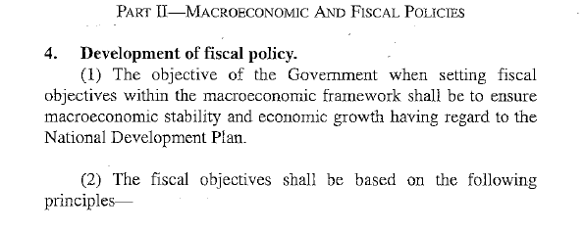
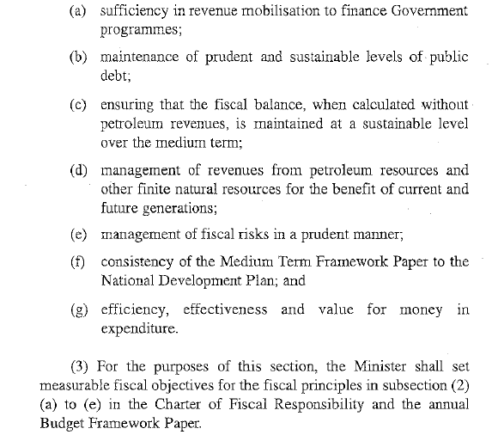
UGANDA

Slide 52
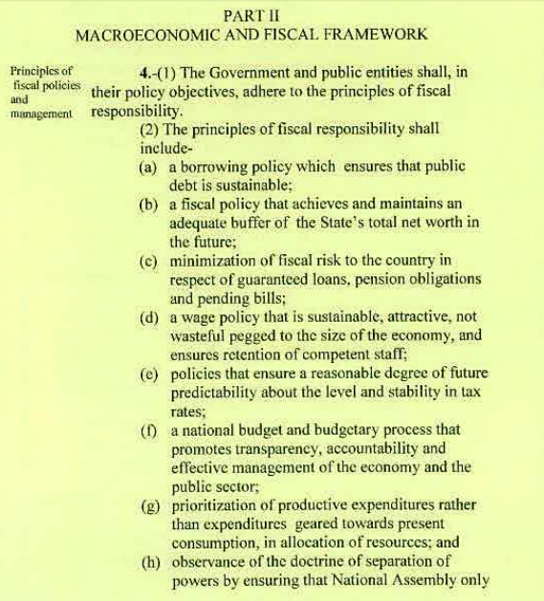
TANZANIA

Slide 53
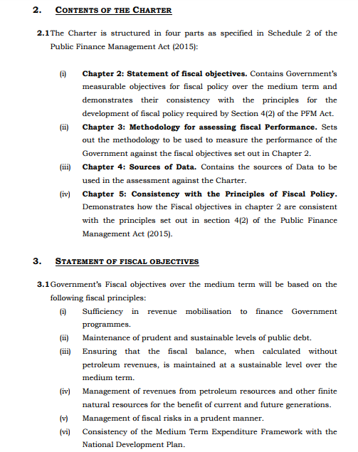
UGANDA : Charter of Fiscal Responsibility

Slide 54

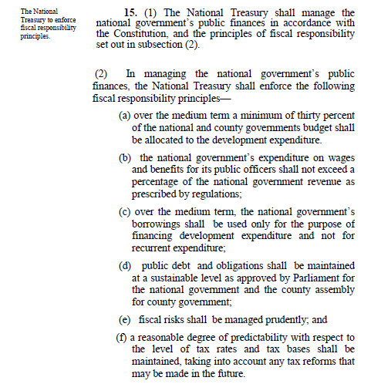
KENYA

Slide 55
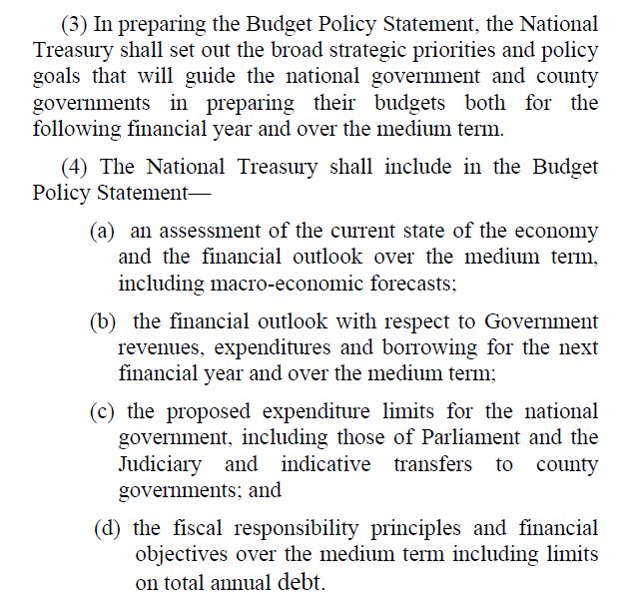
Kenya PFM Act (2012) S(25)

Slide 56
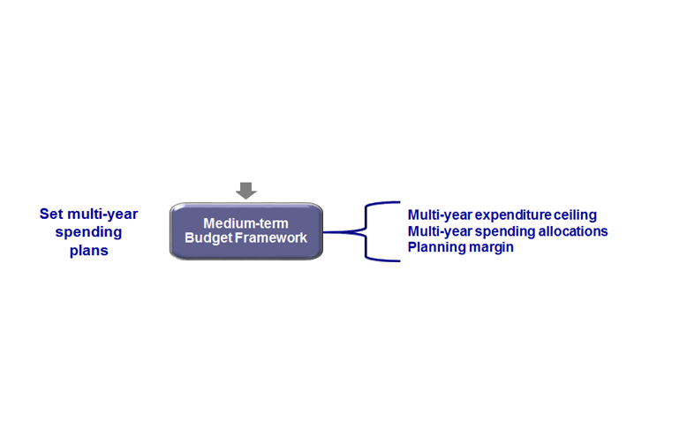
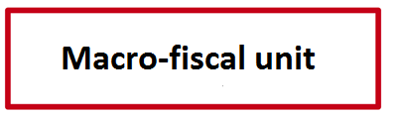
Why do we have an MTFF?
The fiscal framework provides revenue forecasts, macroeconomic parameters, and macroeconomic policy priorities for the budget framework

Slide 57
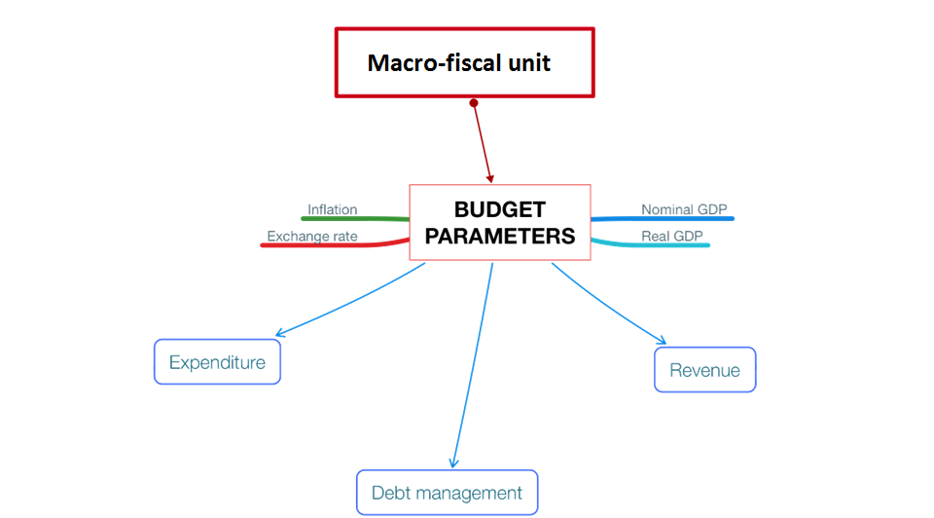
Preparing the MTFF – the role of the macro-fiscal unit in a Ministry of Finance
Notes:
Parameters inform the entire macroeconomic process

Slide 58
The macro-fiscal unit
The output with parameters usually includes:
  Spreadsheet of all macroeconomic variables needed in Budget process (usually internal use)
  Summary table, with key variables presented (published)
  Document presenting economic narrative and risks (published)

Slide 59
The macro-fiscal unit
The output with parameters usually includes:
  Spreadsheet of all macroeconomic variables needed in Budget process (usually internal use)
  Summary table, with key variables presented (published)
  Document presenting economic narrative and risks (published)
What should be in that spreadsheet?

Slide 60
The Budget parameters
The output with parameters usually includes:
  Spreadsheet of all macroeconomic variables needed in Budget process (usually internal use)
  Summary table, with key variables presented (published)
  Document presenting economic narrative and risks (published)
Source: Commonwealth of Australia (2017)

Slide 61
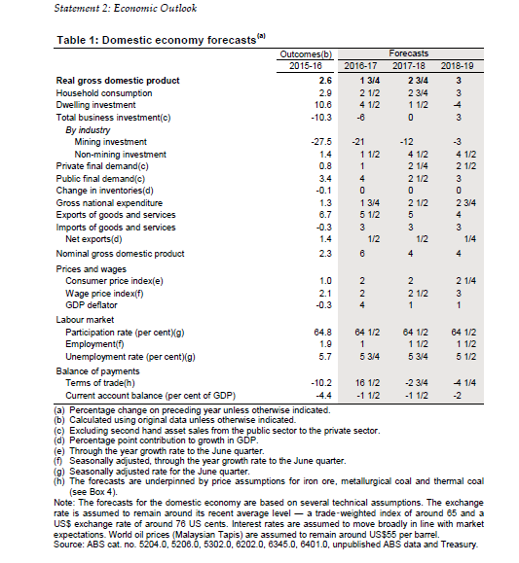
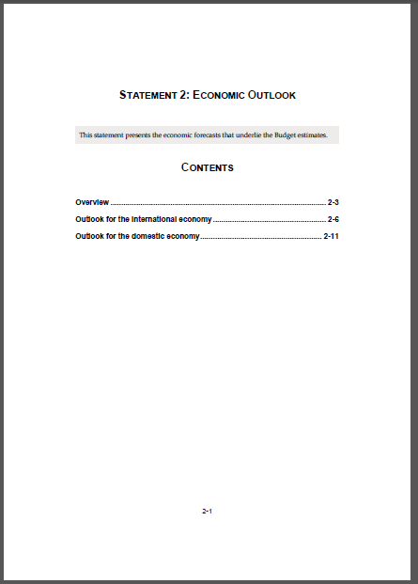
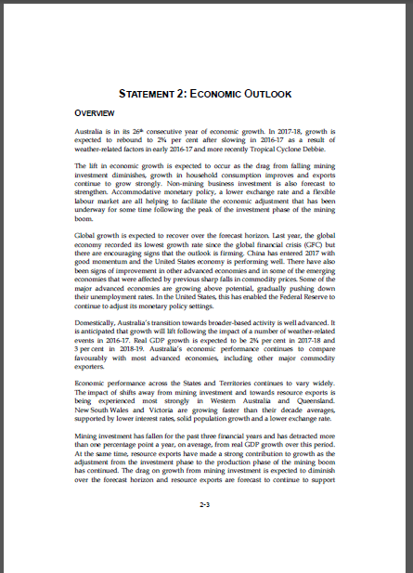
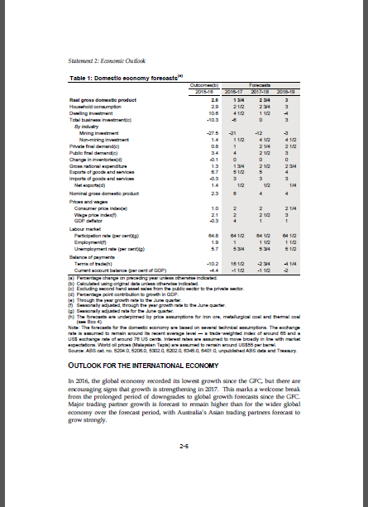
The macro-fiscal unit
The output with parameters usually includes:
  Spreadsheet of all macroeconomic variables needed in Budget process (usually internal use)
  Summary table, with key variables presented (published)
  Document presenting economic narrative and risks (published)

Slide 62
Preparing the MTFF – the role of the macro-fiscal unit in a Ministry of Finance

Slide 63
In fact, the MFU could be doing a whole lot more than just budget parameters…
Other typical outputs of a MFU:
Regular reports on economic conditions
Fiscal policy analysis
Costings of fiscal policies
Debt sustainability analysis
Medium term fiscal strategy
Reports on compliance with fiscal rules
Fiscal risk statements

Slide 64
…but it all requires a lot of data, technical capacity, and interdepartmental goodwill
Data providers
Data
National Statistics Office
Central Bank
Budget directorate
Treasury
Taxation, customs
Debt management
SOE oversight unit
Line ministries
International organisations
Macroeconomic statistics and outturns
Annual budget forecast
In-year revenue and expenditure outturns
Tax base and tax policy developments
Debt statistics
Fiscal risk quantification
World economic indicators
While economics and statistics skills are important for an MFU, communication skills are just as important.

Slide 65
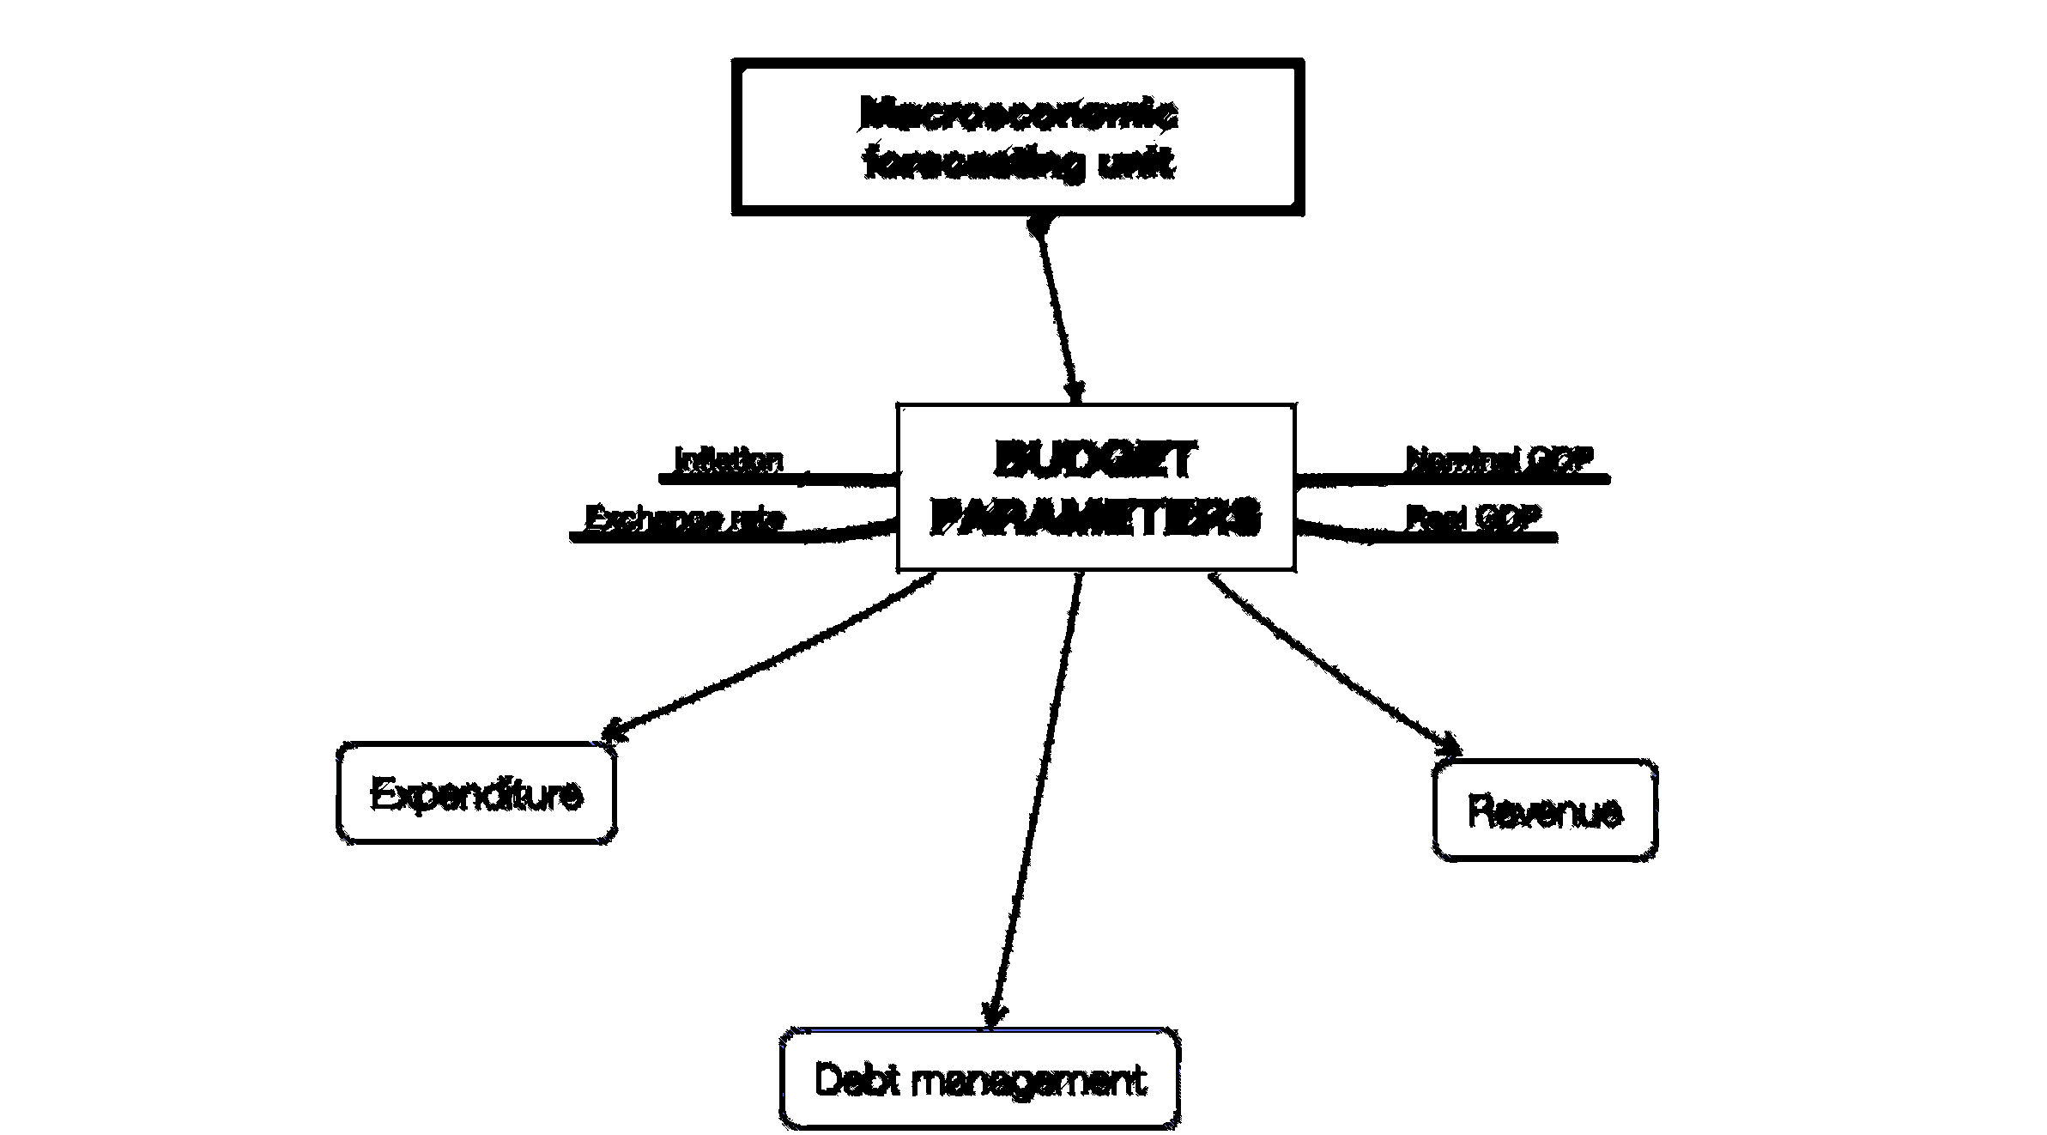
To recap…
HOW WELL DOES THIS WORK?
Transparent budget documentation can help…

Slide 66


A quick example…
Maximum deficit of 2%
Investment to support growth
Managing fiscal risks w buffers
Investment spending delayed
Strong expenditure growth
Deficit exceeds 2%
Debt grows, interest bill rises, GDP growth weaker, inflation increases, fiscal risks grow, sustainability more difficult

Slide 67
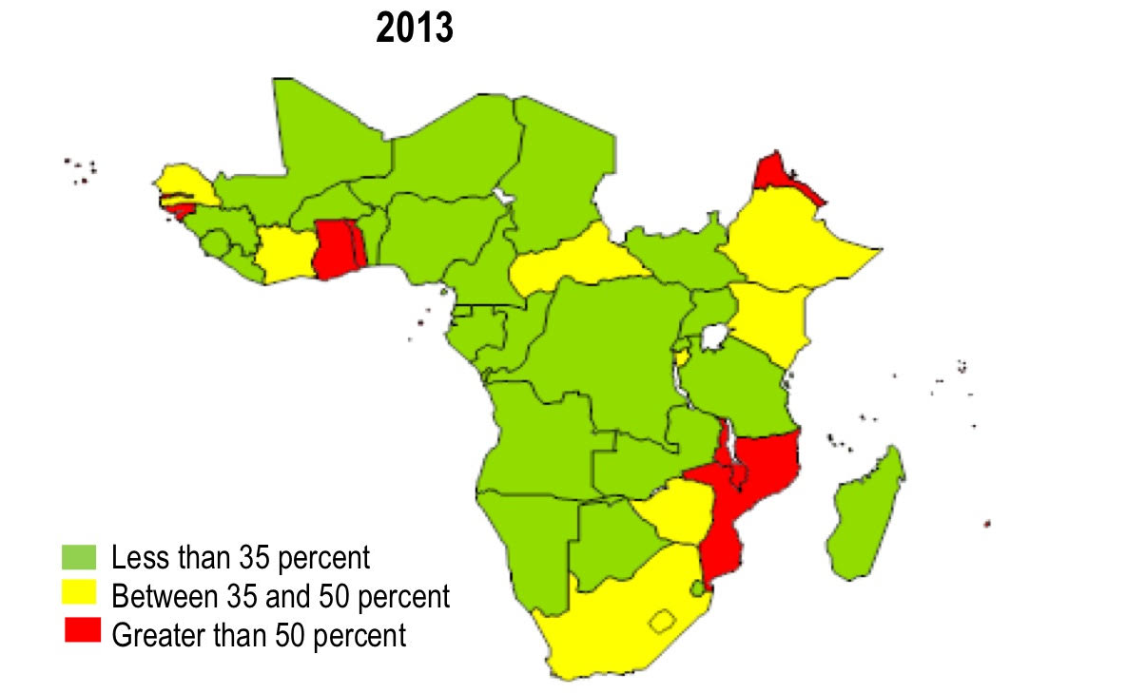

Slide 68
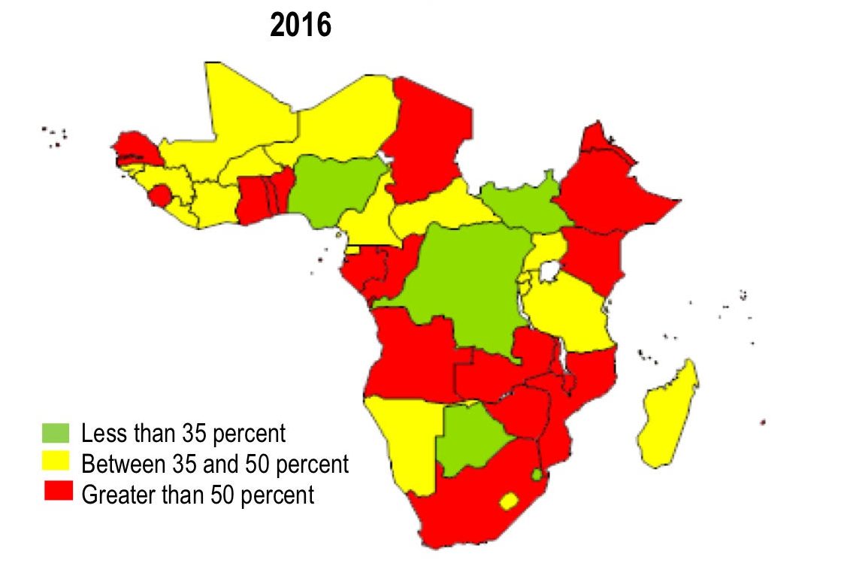

Slide 69
Outline
The Medium Term Fiscal Framework
  What is it, and how does it fit with the Budget?
  Fiscal policy, and why it’s important
  The role of macro-fiscal units
Documenting the framework
  Fiscal transparency
  The fiscal framework in the Budget

Slide 70
Fiscal transparency – a good reason for clear budget documentation
Fiscal transparency is the comprehensiveness, clarity, reliability, timeliness, and relevance of public reporting on the past, present, and future state of public finances
It is critical for effective fiscal management and accountability
    It helps ensure that governments have an accurate picture of their finances when making economic decisions, including of the costs and benefits of policy changes and potential risks to public finances.
    It also provides legislatures, markets, and citizens with the information they need to hold governments accountable

Slide 71
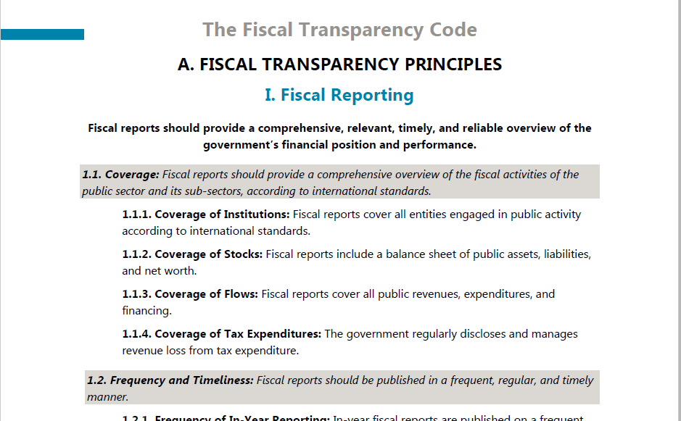

Slide 72
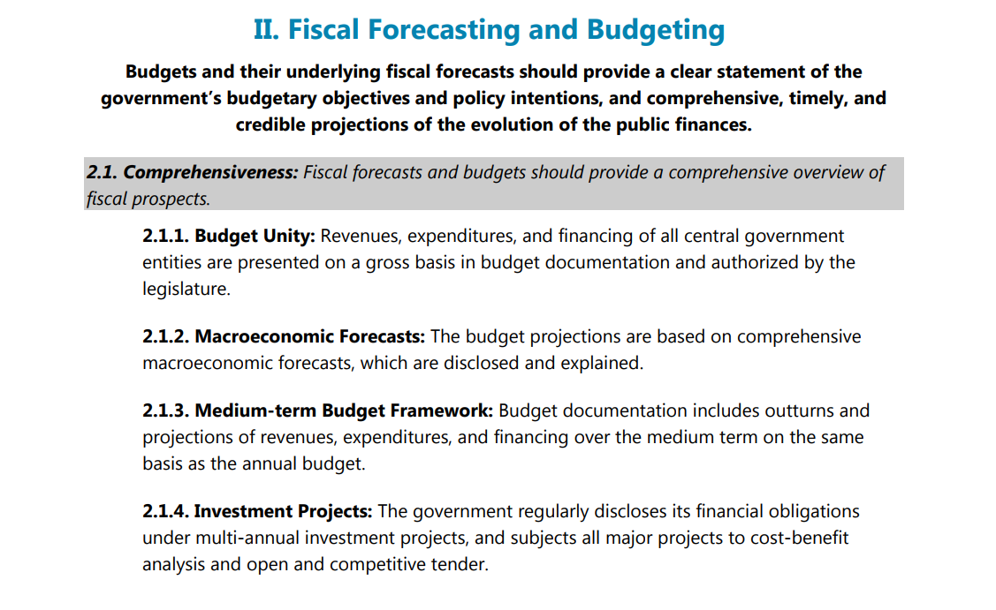

Slide 73
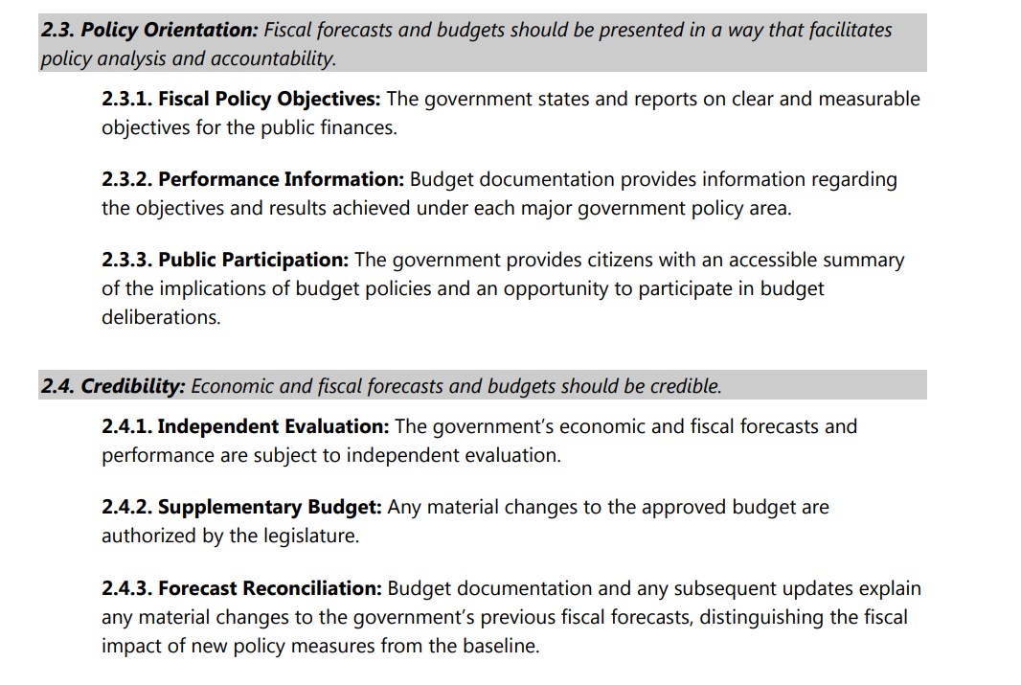

Slide 74
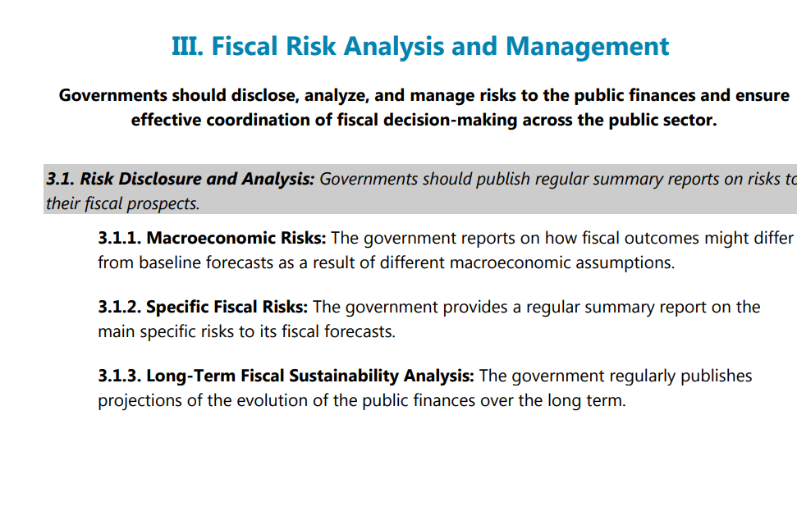

Slide 75

Different types of Budget documents
Pre Budget Statement | Budget Proposal
Citizen’s Budget | Enacted Budget
In-year reports | Mid-year review
Year end-report | Audit report

Slide 76
Different types of Budget documents
Different documents…
Pre Budget Statement | Budget Proposal
Citizen’s Budget | Enacted Budget
In-year reports | Mid-year review
Year end-report | Audit report
…feature different macro-fiscal content
Fiscal strategy and policy
Economic conditions and outlook
Macroeconomic parameters
Fiscal risks and forecast reviews

Slide 77
Fiscal strategy statement
This should lay out the strategic priorities for the forthcoming budget.
It should include the overarching policy goals, the broad economic context.
It should state how the Budget is consistent with the medium term objectives.
And it should highlight the consistency of the Budget with any fiscal rules that have been adopted.

Slide 78
Fiscal strategy statement
Pre Budget Statement
Pre Budget Statement
Budget Proposal
Budget Proposal
Enacted Budget
Citizen’s Budget
Enacted Budget
Citizen’s Budget
In-Year Reports
In-Year Reports
Mid-Year Reports
Mid-Year Reports
Audit Reports
Year-End Reports
Audit Reports
Year-End Reports

Slide 79
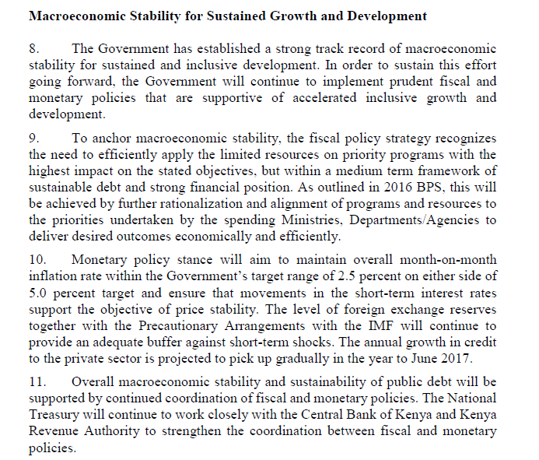
Kenya: Budget Framework Paper

Slide 80
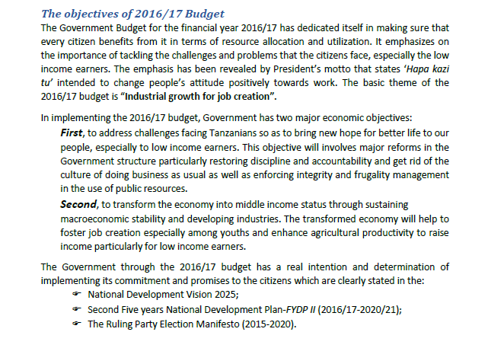
Tanzania: Citizen’s Budget

Slide 81
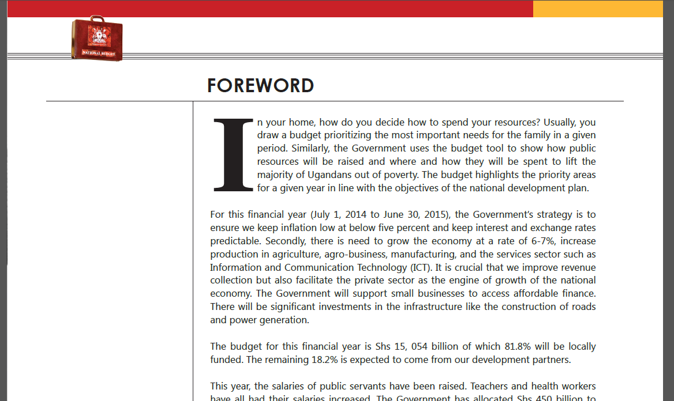
Uganda: Citizen’s Budget 2014-15

Slide 82
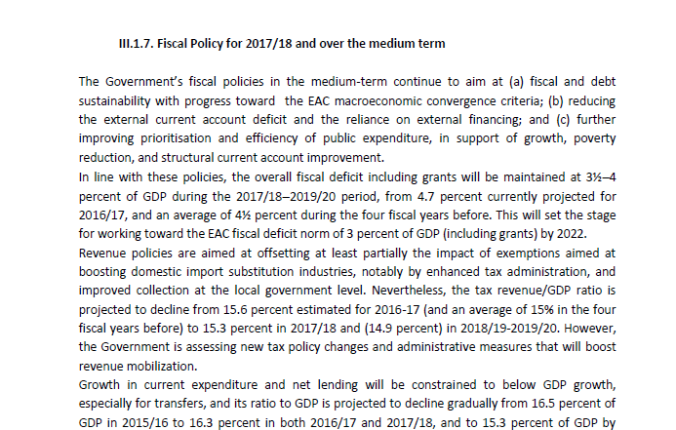
Rwanda: Budget Framework Paper

Slide 83
Economic conditions and outlook
Reports on economic conditions and the outlook provide the macroeconomic narrative for the Budget.
The conditions and outlook form a narrative that should justify the fiscal strategy.
A sound narrative supported by credible estimates and forecasts can add to overall budget credibility (and vice versa!)

Slide 84
Economic conditions and outlook
Pre Budget Statement
Pre Budget Statement
Budget Proposal
Budget Proposal
Enacted Budget
Citizen’s Budget
Enacted Budget
Citizen’s Budget
In-Year Reports
In-Year Reports
Mid-Year Reports
Mid-Year Reports
Audit Reports
Year-End Reports
Audit Reports
Year-End Reports

Slide 85
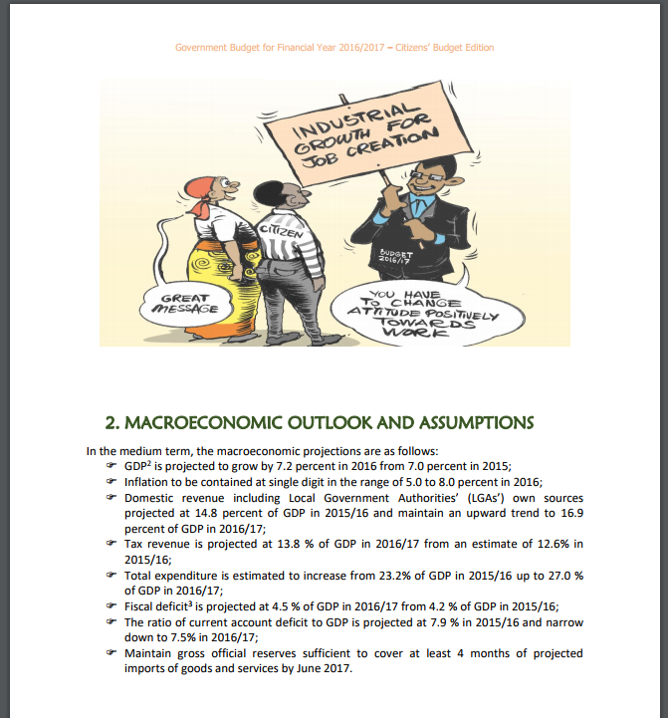
Tanzania: Citizens’ Budget

Slide 86
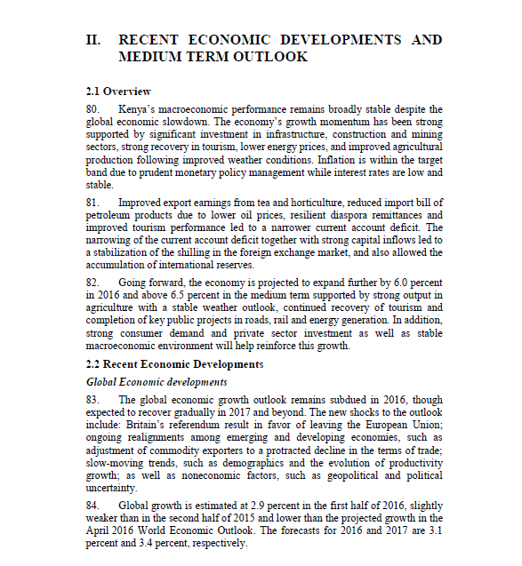
Kenya: Budget Policy Statement

Slide 87
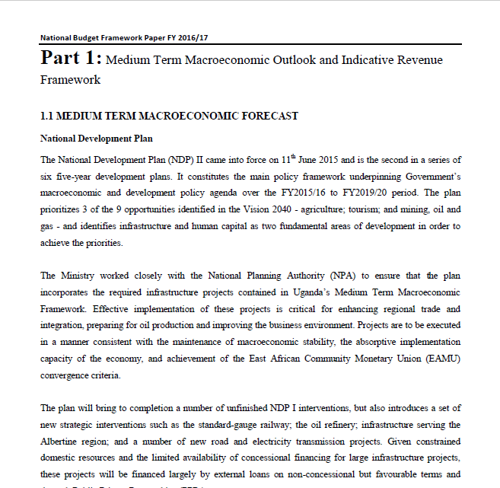
Uganda: Budget Framework Paper

Slide 88
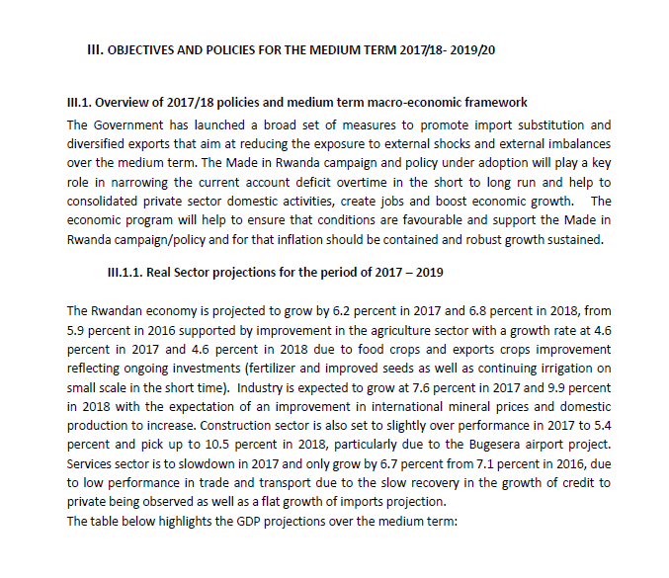
Rwanda: Budget Framework Paper

Slide 89
Publishing the macroeconomic parameters
Publishing the forecasts allows the public to assess the macroeconomic foundation of the Budget.
What should be included in a table of forecasts?

Slide 90
Publishing the macroeconomic parameters
Pre Budget Statement
Pre Budget Statement
Budget Proposal
Budget Proposal
Enacted Budget
Citizen’s Budget
Enacted Budget
Citizen’s Budget
In-Year Reports
In-Year Reports
Mid-Year Reports
Mid-Year Reports
Audit Reports
Year-End Reports
Audit Reports
Year-End Reports

Slide 91
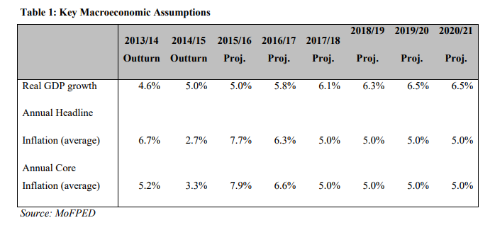
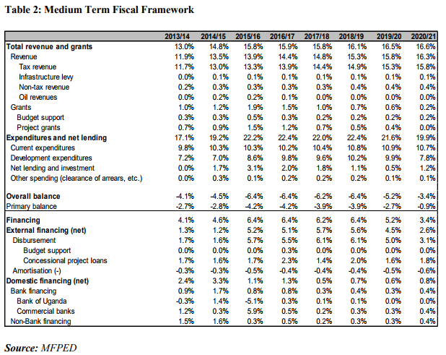
Uganda: National Budget Framework Paper 2016-17

Slide 92
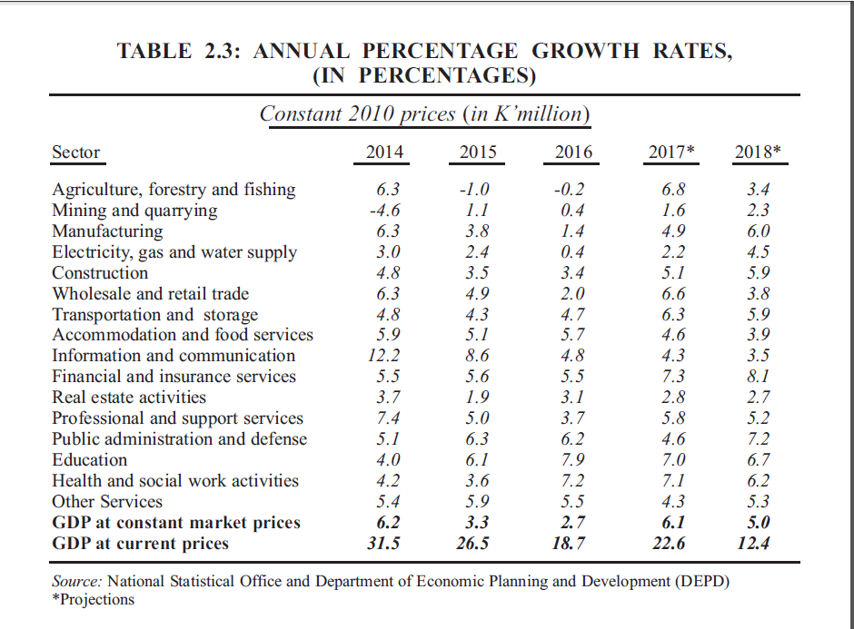
Malawi: Annual Economic Report

Slide 93
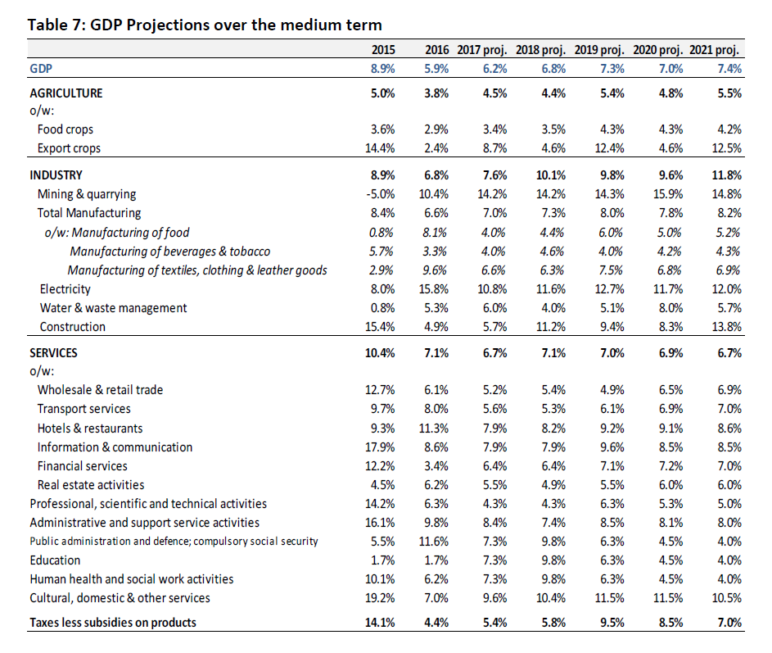
Rwanda: Budget framework paper

Slide 94
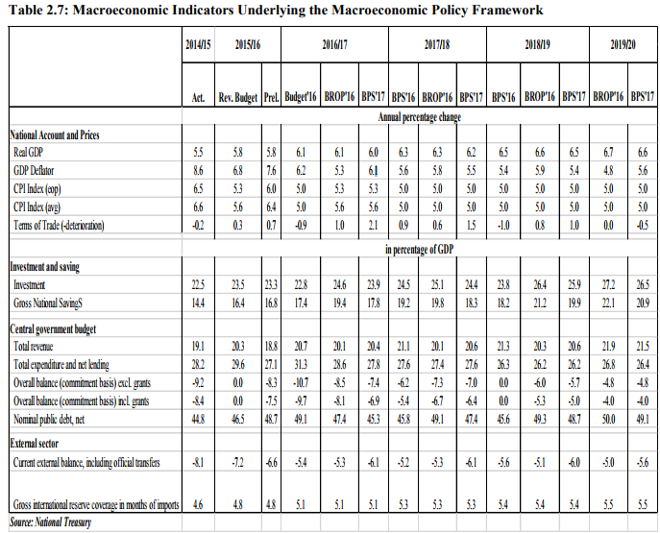

Slide 95
Fiscal risk and forecast analysis:
e.g., Underlying cash balance range
Source: Australian Government Budget Paper 1, 2017-18

Slide 96
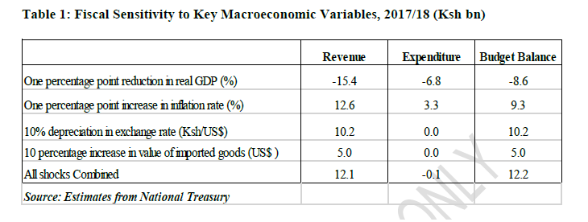
Kenya: Sensitivity to macroeconomic variables

Slide 97
Where are statements of fiscal risk and forecast performance?
Pre Budget Statement
Pre Budget Statement
Budget Proposal
Budget Proposal
Enacted Budget
Citizen’s Budget
Enacted Budget
Citizen’s Budget
In-Year Reports
In-Year Reports
Mid-Year Reports
Mid-Year Reports
Audit Reports
Year-End Reports
Audit Reports
Year-End Reports

Slide 98
Outline
The Medium Term Fiscal Framework
  What is it, and how does it fit with the Budget?
  Fiscal policy, and why it’s important
  The role of macro-fiscal units
Documenting the framework
  Fiscal transparency
  The fiscal framework in the Budget

Slide 99

Key takeaway messages…
Fiscal policy involves setting a clear and consistent set of objectives for the budget
Fiscal policy and strategy should anchor the entire budget process
Keeping this link strong requires an active and engaged macro-fiscal unit
Budget documentation helps to improve accountability and applies pressure to ensure the fiscal and budget frameworks are consistent
A clear, understandable narrative supported by consistent macroeconomic forecasts can help to build support for the fiscal framework.

Slide 100
Discuss

Slide 101
Determining and Communication of Expenditure Priorities
Session 1.4
November 28th, 2017
Florence Kuteesa and Paul Seeds
Entebbe, Uganda

Slide 102
Budget Quotes
What do they say about the budget?
“A billion here, a billion there—sooner or later it adds up to real money.“ -Senator Everett Dirksen
"It's clearly a budget. It's got a lot of numbers in it. - George W. Bush
"A budget tells us what we can't afford, but it doesn't keep us from buying it.“ -- William Feather
Don't tell me what you value, show me your budget, and I'll tell you what you value.” - Joe Biden
“A budget is more than just a series of numbers on a page; it is an embodiment of our values”. Barack Obama, 2005

Slide 103
Outline of Session
PART A: Introduction
Setting of Expenditure Priorities
An Overview of Relevant documentation
PART B: Scope and Content of Documentation
Impact of evolving Budget Principles & related reforms
Select Documentation within AFE Countries
Assessment of the scope & content
PART C: Quality and Relevance of Documentation
Data analysis and classification
Dissemination of information
Notes:
FK?
Decisions at this stage
Key documents
Institutions/skills

Slide 104
PART A: INTRODUCTION

Slide 105
Setting Expenditure Priorities
Importance
Determine the current priorities that are aligned with national priorities and SDGs :
  Ensure multi-year budgetary implication can be accommodated with MTEF
Review new expenditure priorities and multi-year expenditure implications:
  advise on the affordability and prioritization within MTEF
Promote consistence and predictability of funding:
  By allowing in-depth scrutiny by Cabinet and Parliament aimed at :
    Promoting informed prioritization,
    Building consensus on funding strategies and affordable options
    Enhancing ownership, oversight and accountability.

Slide 106
Annual Budget Process & Budget documentation
Strategic Phase
Operational Phase
Q1-Q2 | Q3 | Q4
Legislature
6
Recommendation on Pre Budget Statement
10
Submission to LEG
Approve macro fiscal targets and set fiscal policy (Executive Budget Statement)
1
Cabinet
5
Cabinet approves Pre Budget Statement
Cabinet approve
4
9
BCC (2)
7
MoF and MoPEA
2
Update MTBF(MTEF) (Budget Call Circular)
Pre Budget Statement
Budget Examination (Enacted Budget)
MT expenditure priorities & strategic budget allocations (Mid year review
Enacted Budget
8
MDAs (Sectors)
3

Slide 107
Relevant Budget Documentation
Identification
Documentation published at or around the time of the annual budget that reflect expenditure priorities would include:
  Budget Call Circular & Calendar
  Pre-budget statement (medium-term fiscal or budget strategies at national level)
    Generated from sector or MDAs medium-term budget submission
  Medium-term expenditure framework (MTBF)
Source - IMF(2013)

Slide 108
Relevant Budget Documentation
Purpose and Legal Status
Doc | Purpose | Legal Status
Budget Call Circular | Present guidelines for the “bottom-up budget process”- policy priorities, expenditure ceilings, spending restrictions & formats for presentation of budget | Purpose sometimes prescribed in PFM Act and/ or Budget regulations.
Budget Calendar | Spells out timing for major decision-making points by both executive and policy makers. | Laws provide dates mainly for submission of docs, parliamentary debate and approval.
Pre-budget Statement (Sector) | Presents multi-year expenditure priorities, underlying assumptions, performance targets, funding strategies and indicative expenditure ceilings Historical analysis of the performance of the budget for the last 2 or 4 years & reasons for deviation from estimates | content for the national policy or strategy documents

Slide 109
Relevant Budget Documentation
Purpose and Legal Status
Doc | Purpose | Legal Requirements
MTEF | Presents the multi- expenditure estimates at various levels: aggregate, sector, votes, sometimes disaggregated by broad economic category, source of funding and programs | A requirement by the Law and detailed in the Regulations.

Slide 110
PART B:
SCOPE AND CONTENT OF DOCUMENTATION

Slide 111
Evolving Budgeting Principles & Reforms
Implications on Scope and Content
Principle | Definition | Implication on Scope and Content
Annual Basis | Budget Authority is for a 12- month period Exceptions carry overs for multi-year expenditure commitments. | Expenditure priorities for one FY within a multi-year context.
Universality | All revenues and expenditures are included in the budget | Consolidation of priorities funded by various sources (EBF, donor aid).
Unity | No dual budget system that splits recurrent & capital and earmarks statutory expenditures. | Analysis of expenditure priorities with recurrent and development budgetary implications in one process and documentation But details could be Public Investment Plan

Slide 112
Evolving Budgeting Principles & Reforms
Implications on Scope and Content
Principle | Definition | Implication on Scope and Content
Stability & predictability | Fiscal targets and expenditure ceilings within a medium-term Guides on levels of planning controls. | Clarity of medium-term expenditure priorities and expenditure projections or estimates by aggregate, sector and economic categories and programs. Fitted with given specific Fiscal responsibility Framework or MTFF.
Performance | Expected and past results (outputs/outcomes) of programs reported in the budget | Performance information in- form outcomes, outputs and activities that can be afforded within MTEF
Accountability | Timely and regular financial and non- financial information on budget performance | An account of previous fiscal year’s budget execution, cumulative performance against medium-term expenditure priorities and targets.

Slide 113
Examples of Budget Documentation
Budget Call Circulars
Country | Title | # of Pages
ETH | Budget Call & Financial Calendar
KEN | National Treasury Circular: Guidelines for Preparation of Medium-Term Budget for State Corporation, Semi-Autonomous, Public Funds Etc | 34
MLW | Guidelines for The Preparation Of The 2016/17 Budget | 40
RWA | Planning and Budgeting Call Circular (1) | 8 with many Annexes
TZA | Guidelines For The Preparation Of Annual Plan And Budget In The Implementation Of The Five Year Development Plan (Planning And Budgeting Guidelines ) | 20 (Annexes)
UGA | Budget Call Circular: Preparation of The Budget Framework Papers and Budget Estimates | 13-20

Slide 114
Pre-budget Statement
Samples
Country | Title | # of Pages
ETH | Program Budget Submission
KEN | Sector MTEF Submissions
 | Budget Review and Outlook | 34
 | Budget Policy Statement | 103
MLW | Economic +Fiscal Policy Statement (2015) | 33
TZA | MTEF Submissions by Sectors
 | Plan and Budget Guidelines (Background to the Budget???) | 20 (Annexes)
UGA | Sector Budget Framework Papers
 | National Budget Framework Paper | 454
 | Background to the Budget | 228
 | Ministerial Policy Statements

Slide 115
Access, Scope and Content
Status
Indicator | ETH (2015) | KEN (2012) | MLW (2011) | TZA (2013) | UGA (2012) | RWA 2017
Access to Information (OBI) | NR | 48 | 65 | 46 | 62 | 36
Comprehensiveness of Information
Project Aid information
Unreported Govt Operations |  |  | NR
Existence of costed sector strategies
Investment Expenditure
Performance information

Slide 116
Access, Scope and Content
Emerging Issues
Public access to information on expenditure priorities is varied.
  Limited publication of MTEF and Pre-budget Statement in some countries.
Coverage of expenditure priorities is limited
  Unreported government operations in EBFs or parastatals
  Limited information of donor funded programs.
Presentation of expenditure priorities is NOT inconsistent in all docs
  Case of Uganda – BTTB and BFP
Numerous and frequent budget reforms have, to some extent, compromised quality and relevance of information.
  Served as a disincentive to generate reliable decision and presented in clear format

Slide 117
PART C: QUALITY AND RELEVANCE OF DOCUMENTATION

Slide 118
Quality of Budget Information
PEFA Performance
Change in PEFA scores in the last two (Pre PEFA 2016) assessments for East AFRITAC countries
 |  | ETH 2010/14 | KEN 2008/12 | MLW 2008/11 | RWA 2010/15 | TZA 2010/13 | UGA 2008/12 | ZBR 2010
 | Credibility of the budget
PI 1 | Aggregate expenditure outturn compared to original approved budget | A | B | B | D | B | C | B
PI 2 | Composition of expenditure outturn compared to original approved budget | B+ | C+ | C+ |  | D+ | D+ | A
PI 3 | Aggregate revenue outturn compared to original approved budget | B | B | D | A | C | D | B
PI 4 | Stock and monitoring of expenditure payment arrears | A | C+ | NS | B+ | C | C+ | B
 | Comprehensiveness and transparency
PI 7 | Extent of unreported government operations | NR | D | NS | B+ | D+ | D+ | D+
PI 8 | Transparency of inter-governmental fiscal relations | B | B | B | A | C+ | D+ | NU
PI 10 | Public access to key fiscal information | C | B | C | B | B | B | C
 | Policy-based budgeting
PI 12 | Multi-year perspective in fiscal planning, expenditure policy and budgeting | B | C+ | C+ | B+ | C | C+ | C+
 | Predictability and control in budget execution
PI 16 | Predictability in the availability of funds for commitment of expenditure | C+ | B | B | B+ | C | C+ | C+
 | Accounting, Recording and Reporting
PI 22 | Timeliness and regularity of accounts reconciliation | A | D | D | A | D+ | C+ | B+
PI 23 | Availability of information on resources received by service delivery units | NA | D | D | C | C | B | D
PI 24 | Quality and timeliness of in-year budget reports | C+ | C+ | C+ | D+ | C+ | C+ | C+
PI 25 | Quality and timeliness of annual financial statements | C+ | D+ | C+ | C+ | B+ | C+ | C+
Notes:
Where PEFA2016 assessment has been undertaken, generally not publicized and available – older methodology used here for comparability
Generally: (colour coding is based on whether performance has improved or worsened – not absolute)
PI- 1&2 is an issue – budget composition and aggregate expenditure outturn
PI-4 an emerging issue in many countries and may be worsening from picture here
PI-7 – coverage generally an area for improvement
PI-10 Room for improvement
PI-12 Multi-year perspective an issue
PI-22-24 quality and timeliness a major issue

Slide 119
Transparency of Budget Information
FTE – Selected Indicators

Slide 120
Expenditure priorities - History
Country specific economic sectors only partially aligned to International Standards (COFOG)
Difficult to compare across countries – different functional sectors
Defined percentages of budget allocated to various sectors
Basic designation to define priorities (e.g. number 1 to 4)
This gave some level of analysis for formulating the budget and allocating funds….
But not utilized for reporting purposes, e.g. in IFMIS
Limited performance reporting and difficulties in attributing outcomes to outputs, programs and activities (and effectiveness of input allocations)

Slide 121
Expenditure priorities – recent trends
Increasing use of COFOG classification, usually via mapping to the program segment (e.g. at sub-program level)
Designing the programs around policy objectives and priorities from the outset rather than designing the program and then assigning it to a priority
Previously was open to manipulation by selecting priority objectives largely to justify securing higher levels of funding
Improved harmonization (and linkages) with national plans
Greater focus on performance and outcomes: outputs over inputs
Consistent expenditure policy over the medium term

Slide 122
Priority Objectives
National development plans underpinned by sector plans and strategies
Different policy objectives across countries but high level of commonality
Previously plans attempted to incorporate elements from Millennium Development Goals (MDGs)
Increasingly embedding principles from Sustainable Development Goals (SDGs)
For example: Kenya “mainstreaming” SDGs into MTPIII

Slide 123


Slide 124
Data analysis and classification

Slide 125
Data analysis required for decision making
Needed for decision making - different levels and players
Politicians; planning; budget office; sector groups; MDAs; external finance/affairs; local government; etc.
Need a consolidate view of all activities in the public sector – avoid redundancy and overlap
Need to link budget to national development overarching objectives and priorities
Important role of PBB performance outputs and outcomes – results chain:
  Budget costing of programs, sub-programs and activities (supporting the policy objectives)
  Defining key performance indicators (KPIs) and target and outcomes
  Demonstrate clearly the linkage between inputs, outputs and outcomes

Slide 126
Data analysis required for decision making
Need ability to define budget ceilings and present budget submissions by sector (COFOG) and policy objectives, to demonstrate how programs are contributing to policy objectives and justify priority spending areas
Reporting (monitoring) actual outcomes: both financial and non-financial reporting by program segment, sector, and policy objectives (various dimensions)
Determining: Is a program/sub-program/activity performing or underperforming; are they still contributing to the overall policy objectives and priorities (results chain assumptions valid?)
Decisions: Should program exist?; should it be expanded or reduced? Does it require additional complementary inputs/outputs – different sub-programs?
Need to be able drill-down on data to detailed level

Slide 127
Data analysis for influencing
Often want to do more than inform but want to influencing stakeholders - to gain consensus on decisions and/or buy-in to policy objectives, interventions (e.g. highly prominent projects) etc.
Making compelling arguments to influence allocation of funds towards priority areas and designated sectors
Demonstrate percentages allocated and spent against each sector, priority program, etc. - summary (graphical) presentation with drill down capabilities
Presenting alternative options - different models/scenarios and “what-ifs” – clearly demonstrating the respective impact of the different scenarios
Justification for the approved interventions – highlighting the longer term anticipated outcomes and intermediate milestones for their achievement
Demonstrate and publicize quick hit wins and progress towards longer term achievements

Slide 128
Data analysis required for communication
Needed for communication and information, e.g. informing the public, CSOs, DPs, etc., as well as politicians, MDAs, etc.
What are the key message to be disseminated?
How much is being spent in different sectors of the economy?
What the priority spending areas are?
Past performance – impact of spending – what has been achieved
Public participation in planning, budgeting and accountability processes

Slide 129
Data analysis required for communication
Different messages for different audiences - debunk terminology and technical jargon
Different messages (focus) for different groups
Focused information – charts, diagrams, infographics, to present summarised information effectively – with drill down to the underlying data (allowing further analysis by key stakeholder groups)
Immediate impact of message
  Easy to read
  Planned priorities, budget priorities, and actual performance
  Quick hit wins
Avoid overloading readers with too much data (data graveyard)

Slide 130
Data classification and the CoA
A well designed classification structure is a prerequisite for effective data analysis and dissemination
The primary classification is a multi-dimensional (multiple segment) COA:
  Administrative segment (organizational dimension)
  Funding Segment (Source of funds)
  Economic Item (category and nature of expenditure )
  Program, sub-program, activity segment (purpose of spending)
  Geographical segment (beneficiary region of spending)
Classifications used by planning, budget preparation, budget execution, accounting and reporting systems
Additional dimensions mapped to CoA……

Slide 131
Extending the analysis
Additional dimensions mapped to CoA, e.g. economic sectors, COFOG, policy objectives, development priority classifications, scope for mapping to SDGs, etc.
Classifications used by planning, budget preparation, budget execution, accounting and reporting systems
Mapping to priority activities (themes, pillars, etc.) from National Plans
Can link inputs to the priorities – do allocations reflect stated policy objectives and priorities?
Are the priorities weighted and ranked? How can we achieve this?

Slide 132
Pros and Cons of mapped classifications
If no mapping:
  would require all end users to be fully conversant with all other classifications and how to code all transactions correctly
  Classification likely to be applied inconsistently – proliferation of errors
  Added complexity when processing transactions
Mapping not without challenges:
  Errors in initial mapping impact on data analysis
  Often many to many relationships – need to determine the main primary sector, policy objective, etc.
  Need to avoid overcomplexity (at what level mapping to be undertaken)
  Mapping tables need ongoing review; Need central capacity to do this

Slide 133
Effective data analysis
Requires appropriate multi-dimensional classifications
The chart of accounts (CoA) and other classifications tagged against all transactions in the system
Mechanism to link inputs, outputs, outcomes e.g. costs against policy objectives
Measurable outputs and outcomes against a program or sub-program
How far down do we need to go with measuring and attributing performance? Need to avoid subjectivity
Business intelligence tools fundamental to unlocking the data - modern, flexible and powerful reporting tools
Variety of presentations, formats, groupings, slicing and dicing for different user needs…… Need for a CIO?

Slide 134
Systems and Business Intelligence Tools
Usually separate systems for long term planning and macro-fiscal forecasting
Planning and Budget: Some countries use a the standard IFMIS module; others use associated tools (e.g. Hyperion/Oracle Financials)
Core IFMIS – Budget execution, treasury, accounting and reporting system
Critical considerations include sharing of data, and consistency in analysis via shared tables for CoA and other classifications
Utility of the systems enhanced via use of reporting and business intelligence tools
Need knowledge of the core data stores and skills in presenting the information in different formats for the various users – understanding the information needs of different stakeholders

Slide 135
Dissemination of Information

Slide 136
Presenting the Priorities
Presentation in plans an budgets – how well communicated are the core priorities?
Does the budget document highlight:
  What the priorities are? With a ranking?
  Why those activities have been prioritized (including link to national plan)?
  What the expected outcomes are (over the medium term)
  Percentage of resources allocated to them
  Past performance on the priority areas?
  Summary level v detailed level

Slide 137
Paper v Electronic
Paper still has its place and not fully replaced by electronic means
Accessing the data is important – use of both hard copy (paper) and soft copy information accessed via website
For example, hard copy of budget estimate books, national plans, brochures showing citizens budget, audited accounts, etc. but how well are the priorities highlighted in these documents
Often presentation is better delivered through the website as it can reach much wider and information can be presented in a variety of formats
Electronic access available not just on computers but also on mobile phones, tablets and other devices

Slide 138
Website presentation – good traits
Orderly - needs to be well laid out – user friendly and uncluttered
Intuitive – do not need to be a technical expert to find way around the information
All information accessible through menus or search functions – e.g. not through typing the search into the URL
User should be able to access data at various levels of detail or aggregation, ideally – high level summary view (graphical) with drill down
Access to underlying data in reusable format not a pdf picture of a scan (as encountered elsewhere) – users want to undertake their own analysis
Question – we all have budget documentation on our websites but how visible are the priority programs, subprograms, activities?

Slide 139
Web presentation – use of graphics
An old saying: “a picture paints a thousand words”
Use of graphical presentations – infographics, dashboards, etc.
Being wordy can often bury the information user – especially the lay person
New Zealand (and many others) have good websites, which are easy to navigate and find what you are looking for
For example – how might we present budget priorities?

Slide 140

















Example….

Slide 142
Thank You

